Slide 1


Zackary Ashworth
07/27/24

Slide 2

Outline
Executive Summary
Introduction
Methodology
Results
Conclusion
Appendix

Slide 3
Executive Summary
Summary of methodologies
Models:
Created and tested classification models using Sklearn
Interactive Mediums:
Folium maps and Dash web-application
EDA:
Visualized with Seaborn and explored with SQL
Data Wrangling:
Processed using Pandas
Data Collection:
SpaceX API and Web Scraping Wikipedia
Summary of all results:
Classification of successful recovery at 87% accuracy
Goals:
Determine if a SpaceX first stage Rocket will land

Slide 4
Introduction
Reusing first stage rockets saves a lot of money
Determining if a spaceX rocket will or will not land will determine how much more or less expensive that launch is
What features are the biggest influence on a successful recovery?
What level of accuracy can we expect to predict for any given launch?

Slide 5

Section 1

Slide 6
Methodology
Executive Summary
Data collection methodology:
Collected using the SpaceX API and web-scraping wikipedia
Perform data wrangling
Processed using Python and Pandas
Perform exploratory data analysis (EDA) using visualization and SQL
Perform interactive visual analytics using Folium and Plotly Dash
Perform predictive analysis using classification models
Evaluated with Scikit-learn, and several classification models: SVM, Logistic Regression, Decision Tree, and K-nearest neighbors.

Slide 7
Data Collection
Data Sets were collected via SpaceX API and via web-scraping Wikipedia
Some data from the SpaceX API needed to be processed separately and added to the dataframe using specially built helper functions.
Data Scraped from Wikipedia had to be processed using the BeautifulSoup library to extract relevant tabular data

Slide 8
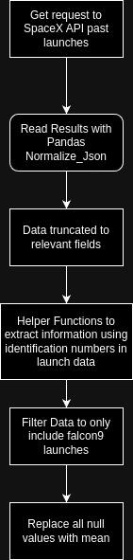
Data Collection – SpaceX API
Data from SpaceXAPI: specifically the v4 past launches
"https://api.spacexdata.com/v4/launches/past"
https://github.com/Vocantes/Data_Science_Captstone_IBM/blob/main/jupyter-labs-spacex-data-collection-api.ipynb

Slide 9
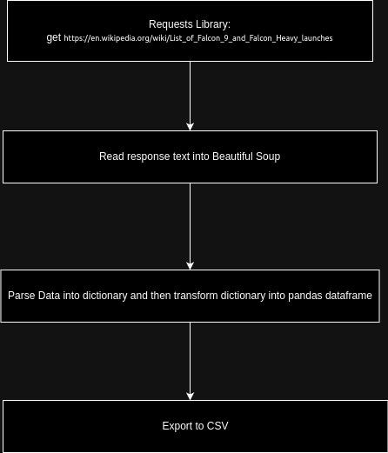
Data Collection - Scraping
Data was scraped from wikipedia and then processed using the requests and BeautifulSoup Libraries.
https://en.wikipedia.org/wiki/List_of_Falcon_9_and_Falcon_Heavy_launches
https://github.com/Vocantes/Data_Science_Captstone_IBM/blob/main/jupyter-labs-webscraping.ipynb

Slide 10
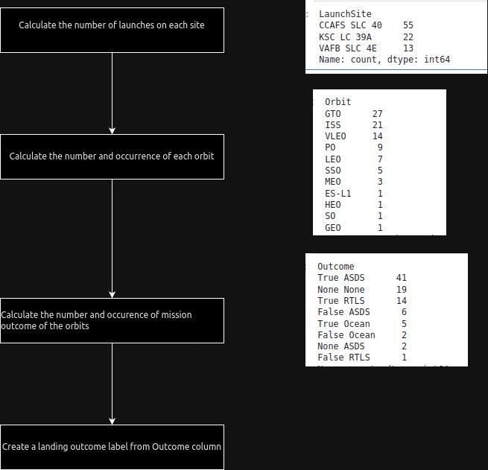
Data Wrangling
Data was processed by using basic pandas functions and applying filters.
https://github.com/Vocantes/Data_Science_Captstone_IBM/blob/main/labs-jupyter-spacex-Data%20wrangling.ipynb

Slide 11
EDA with Data Visualization
In the visual EDA of this project several charts were plotted:
-Flight Number and Launch Site
Payload and Launch Site
Success Rate of each Orbit Type
Flight Number and Orbit Type
Payload Mass and Orbit Type
https://github.com/Vocantes/Data_Science_Captstone_IBM/blob/main/jupyter-labs-eda-dataviz.ipynb

Slide 12
EDA with SQL
There were several SQL Queries performed on the data:
Display the names of the unique launch sites in the space mission
Display 5 records where launch sites begin with the string 'CCA'
Display the total payload mass carried by boosters launched by NASA (CRS)
Display average payload mass carried by booster version F9 v1.1
List the date when the first succesful landing outcome in ground pad was acheived.
List the names of the boosters which have success in drone ship and have payload mass greater than 4000 but less than 6000
List the total number of successful and failure mission outcomes
List the names of the booster_versions which have carried the maximum payload mass. Use a subquery
List the records which will display the month names, failure landing_outcomes in drone ship ,booster versions, launch_site for the months in year 2015.
Rank the count of landing outcomes (such as Failure (drone ship) or Success (ground pad)) between the date 2010-06-04 and 2017-03-20, in descending order
https://github.com/Vocantes/Data_Science_Captstone_IBM/blob/main/jupyter-labs-eda-sql-coursera_sqllite.ipynb

Slide 13
Build an Interactive Map with Folium
The Folium Map had markers added to denote certain locations:
The launch sites
The successful and failed launches
The distance between launch sites and it’s proximities, such as:
- railways
- highways
-coastlines
These were added in order to determine if there was a geographic pattern in launch site locations.
https://github.com/Vocantes/Data_Science_Captstone_IBM/blob/main/lab_jupyter_launch_site_location.ipynb

Slide 14
Build a Dashboard with Plotly Dash
A few interactive graphs and plots were created using Plotly and Dash:
A pie chart of total successes filtered either by all sites or by specific sites
A scatter chart plotting payload weight vs successful launches filtered by all sites or specific sites; it is also filtered via range of payload weight
These were chosen to quickly view the effects that specific launch sites and payload weight has on successful launches.
https://github.com/Vocantes/Data_Science_Captstone_IBM/blob/main/spacex_dash_app.py

Slide 15
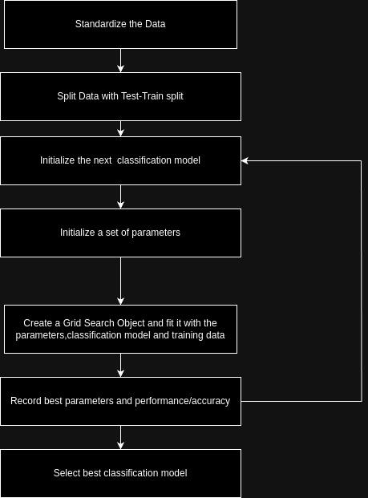
Predictive Analysis (Classification)
Summarize how you built, evaluated, improved, and found the best performing classification model
The classification model was built, evaluated and improved using a test train split and Grid Search on several different classification models:
-Logistic Regression
-Search Vector Machine
- Decision Tree Classifier
-K-nearest neighbors
The best performing classification model appears to be a decision tree classifier with an accuracy score of 87.67%
https://github.com/Vocantes/Data_Science_Captstone_IBM/blob/main/SpaceX_Machine_Learning_Prediction_Part_5.jupyterlite.ipynb

Slide 16
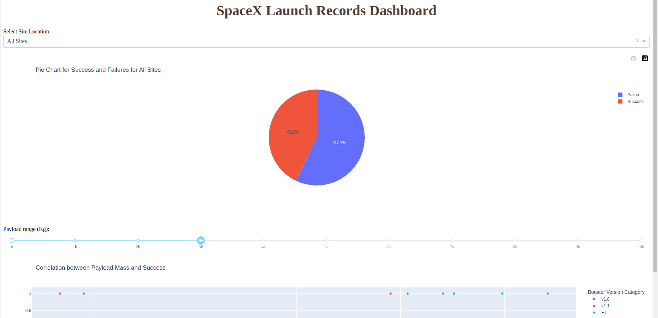
Results
Interactive Analytics Demo
Exploratory data analysis results
Relevant fields:
'FlightNumber', 'PayloadMass', 'Orbit', 'LaunchSite', 'Flights', 'GridFins', 'Reused', 'Legs', 'LandingPad', 'Block', 'ReusedCount', 'Serial'
Predictive analysis results
Decision Tree classification model:
87.67% Accuracy

Slide 17

Section 2

Slide 18
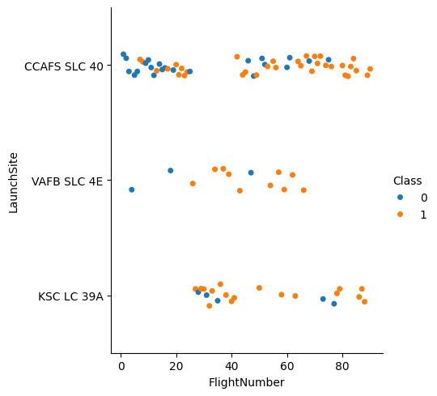
Flight Number vs. Launch Site
Generally, as the flight number increases the launch site’s success rate goes up

Slide 19
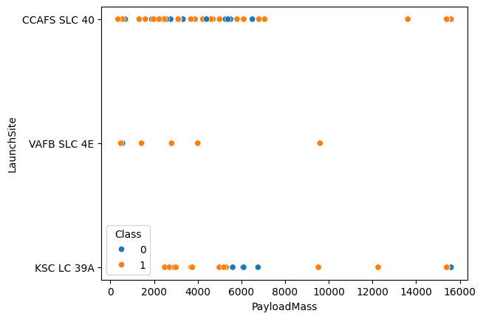
Payload vs. Launch Site
The launch site VAFB SLC 4E appears to not launch heavy payloads at all and most payloads from all sites are less than 10000

Slide 20
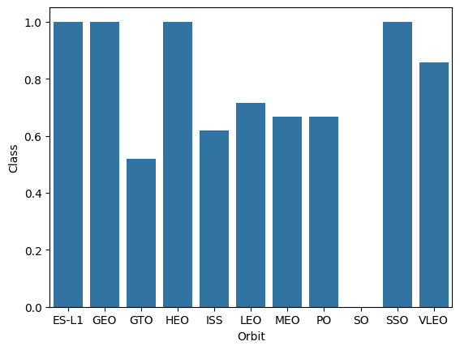
Success Rate vs. Orbit Type
Certain Orbits tend towards higher success rates and others towards lower.
There is a lack of data on certain orbits that may make the data appear more favorable than in practice.

Slide 21
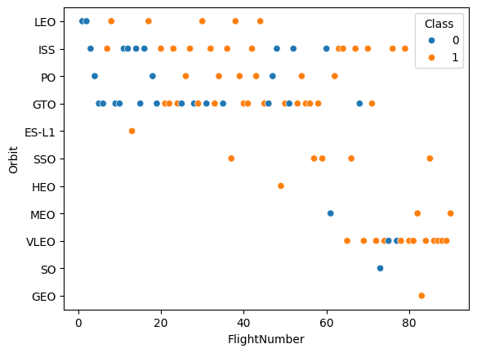
Flight Number vs. Orbit Type
For some Orbits such as LEO success rates increase as Flight Numbers increase
For other Orbits the Flight Number appears to have little to no correlation to success rate

Slide 22
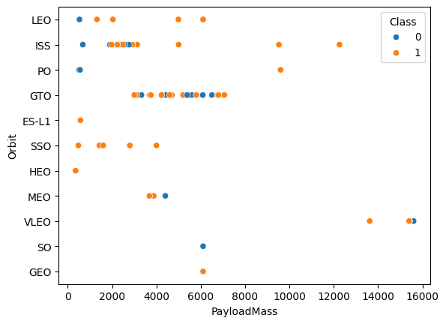
Payload vs. Orbit Type
The Heavier Payloads tend to only be sent out on certain orbits: ISS, PO, VLEO
PO and ISS orbits are more likely to succeed for Heavy Payloads

Slide 23
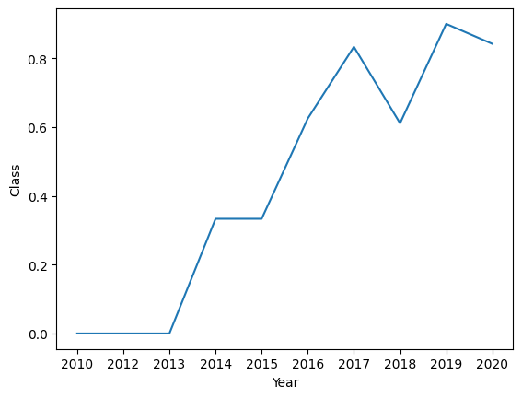
Launch Success Yearly Trend
As years go by, the success rate of Launches tend to increase with a dip in 2018 and 2020

Slide 24
All Launch Site Names
Query:
“%sql SELECT DISTINCT "Launch_Site" FROM SPACEXTABLE “
Result:
Launch_Site
CCAFS LC-40
VAFB SLC-4E
KSC LC-39A
CCAFS SLC-40
This query gets all launch site values and filters them down to only the unique values

Slide 25
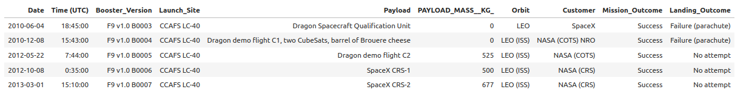
Launch Site Names Begin with 'CCA'
Query:
“%sql SELECT * FROM SPACEXTABLE WHERE "Launch_Site" LIKE "CCA%" LIMIT 5;”
This query selects the first 5 rows from the database where launch sites start with CAA
Result:

Slide 26
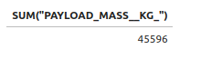
Total Payload Mass
Query:
“%sql SELECT SUM("PAYLOAD_MASS__KG_") FROM SPACEXTABLE WHERE "Customer" LIKE "NASA (CRS)";”
Result:
This query filters the customer to be NASA (CRS) and then sums up all values in the Payload mass KG column.

Slide 27
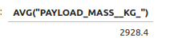
Average Payload Mass by F9 v1.1
Query:
%sql SELECT AVG("PAYLOAD_MASS__KG_") FROM SPACEXTABLE WHERE "Booster_Version" = "F9 v1.1" GROUP BY "Booster_Version"
Result:
This query filters the results to where booster_version is F9 v1.1 and then Averages the result of the payload mass column.

Slide 28
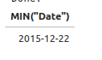
First Successful Ground Landing Date
Query:
%sql SELECT MIN("Date") FROM SPACEXTABLE WHERE "Landing_Outcome" LIKE "Success (ground pad)";
Result:
This Query filters the results to where the landing outcome is a successful ground pad and then selects the minimum value from the Date column.

Slide 29
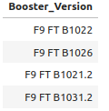
Successful Drone Ship Landing with Payload between 4000 and 6000
Query:
“%sql SELECT "Booster_Version" FROM SPACEXTABLE WHERE "Landing_Outcome" = "Success (drone ship)" AND "PAYLOAD_MASS__KG_" > 4000 AND "Payload_MASS__KG_" < 6000;”
Result:
The Query selects Booster versions where the Landing outcome is a successful drone ship and where their payload mass is lower than 6000 and greater than 4000

Slide 30
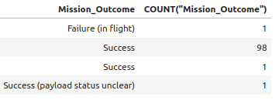
Total Number of Successful and Failure Mission Outcomes
Query:
%sql SELECT "Mission_Outcome", COUNT("Mission_Outcome") FROM SPACEXTABLE GROUP BY "Mission_Outcome";
Result:
This query selects and groups the mission outcomes into distinct categories and then counts the number of entries in each category.

Slide 31
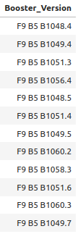
Boosters Carried Maximum Payload
Result
Query:
%sql SELECT DISTINCT("Booster_Version") FROM SPACEXTABLE WHERE "PAYLOAD_MASS__KG_" = (SELECT MAX("PAYLOAD_MASS__KG_") FROM SPACEXTABLE)
This query filters the data to include only results that are equal to a subquery that computes the maximum payload mass. Then it outputs only the Booster_versions that have delivered payloads of that weight

Slide 32
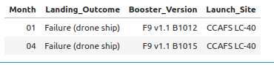
2015 Launch Records
Query:
%%sql SELECT SUBSTR("Date",6,2) AS "Month", "Landing_Outcome", "Booster_Version", "Launch_Site"
FROM SPACEXTABLE
WHERE "Landing_Outcome" LIKE "Failure%" and SUBSTR("Date",0,5) = "2015"
ORDER BY "Month"
This query gets the month from the date column, the Landing outcome, Booster version and Launch site location from rows where the landing outcome is some form of failure and the year in the date column is 2015.
Result

Slide 33
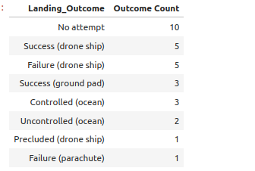
Rank Landing Outcomes Between 2010-06-04 and 2017-03-20
Query:
%sql SELECT "Landing_Outcome", COUNT("Landing_Outcome") AS "Outcome Count" FROM SPACEXTABLE WHERE DATETIME("Date") > DATETIME("2010-06-04") AND DATETIME("Date") < DATETIME("2017-03-20") GROUP BY "Landing_Outcome" ORDER BY "Outcome Count" DESC;
This query filters the rows to only be between 2010-06-04 and 2017-03-20. It then Groups the results by their Landing Outcome and counts the number of rows in each outcome. Then it orders the results in descending order by their counts.
Result

Slide 34

Section 3

Slide 35
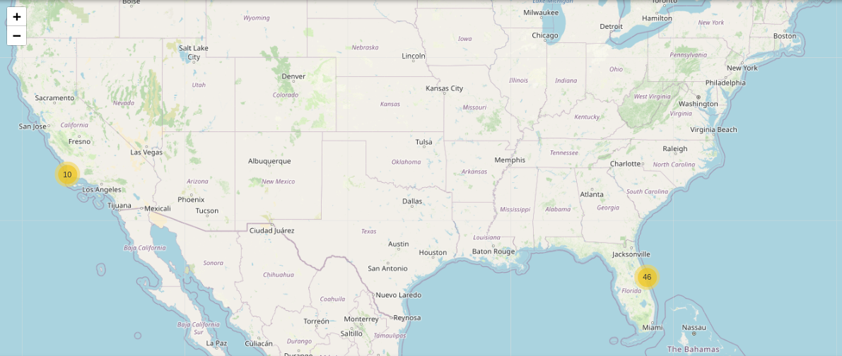
Folium Map of All Launch Site locations
This Map Shows all the locations that SpaceX launches occur

Slide 36
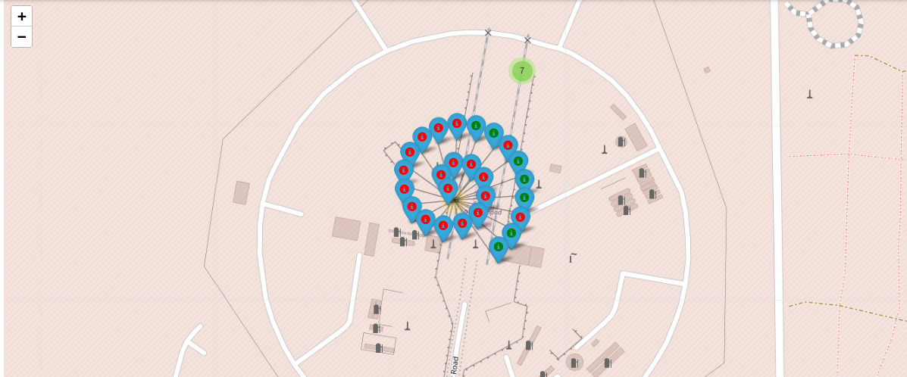
Folium Map of Launch Outcomes
This map color codes the result of each launch from each location. It helps visualize which launch sites tend towards more successful launches.

Slide 37
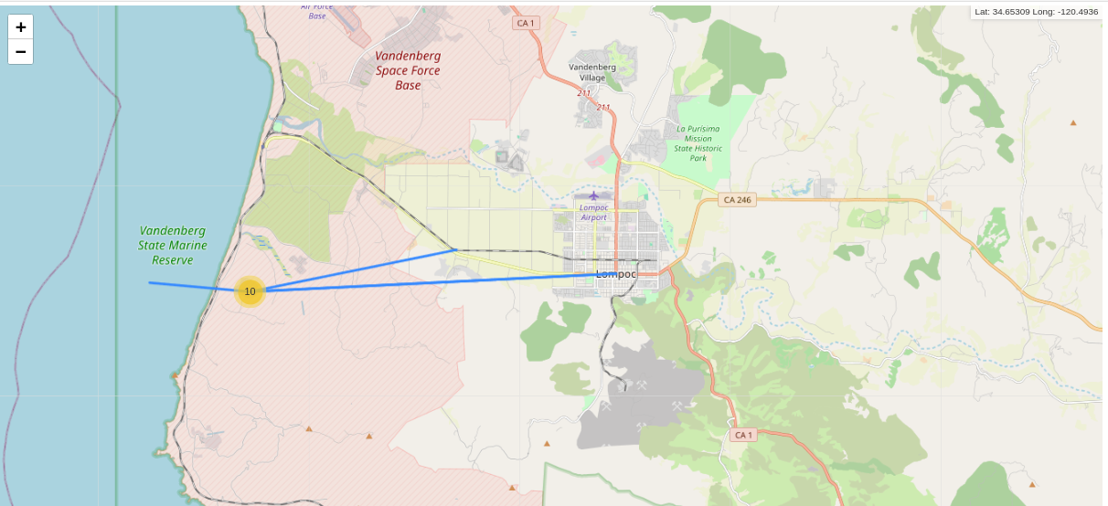
Folium Map of Proximities
This Folium Map shows the proximity of highways, coastlines and railways near the california launch site. As you can see all of those things are fairly close by

Slide 38

Section 4

Slide 39
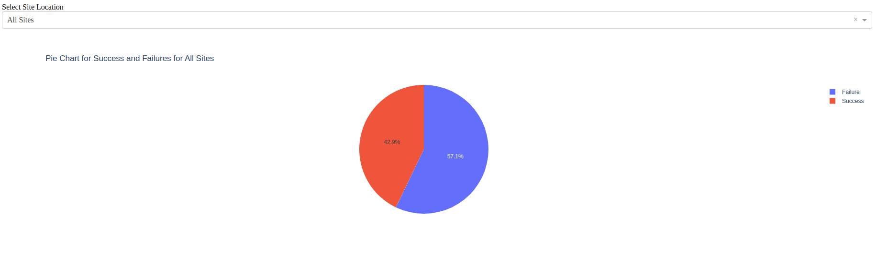
Pie chart of Successful Launches for All Sites
This Pie chart shows that the majority of launches from all sites are failures

Slide 40
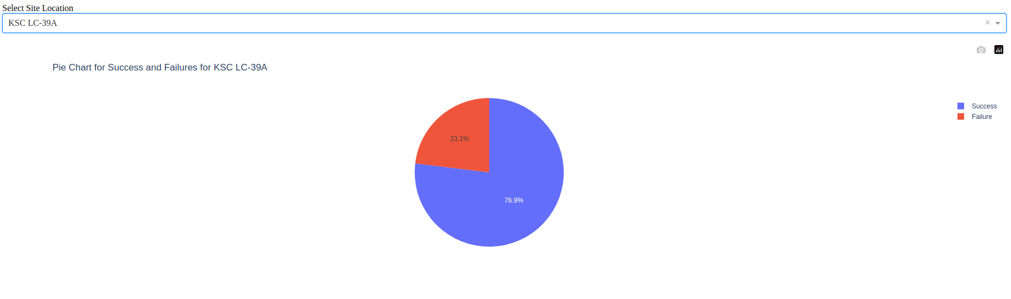
Pie chart of launch site with highest launch success ratio
This pie chart shows that there is a significantly larger amount of success than failures from KSC LC-39A than from other locations or the average.
Explain the important elements and findings on the screenshot

Slide 41
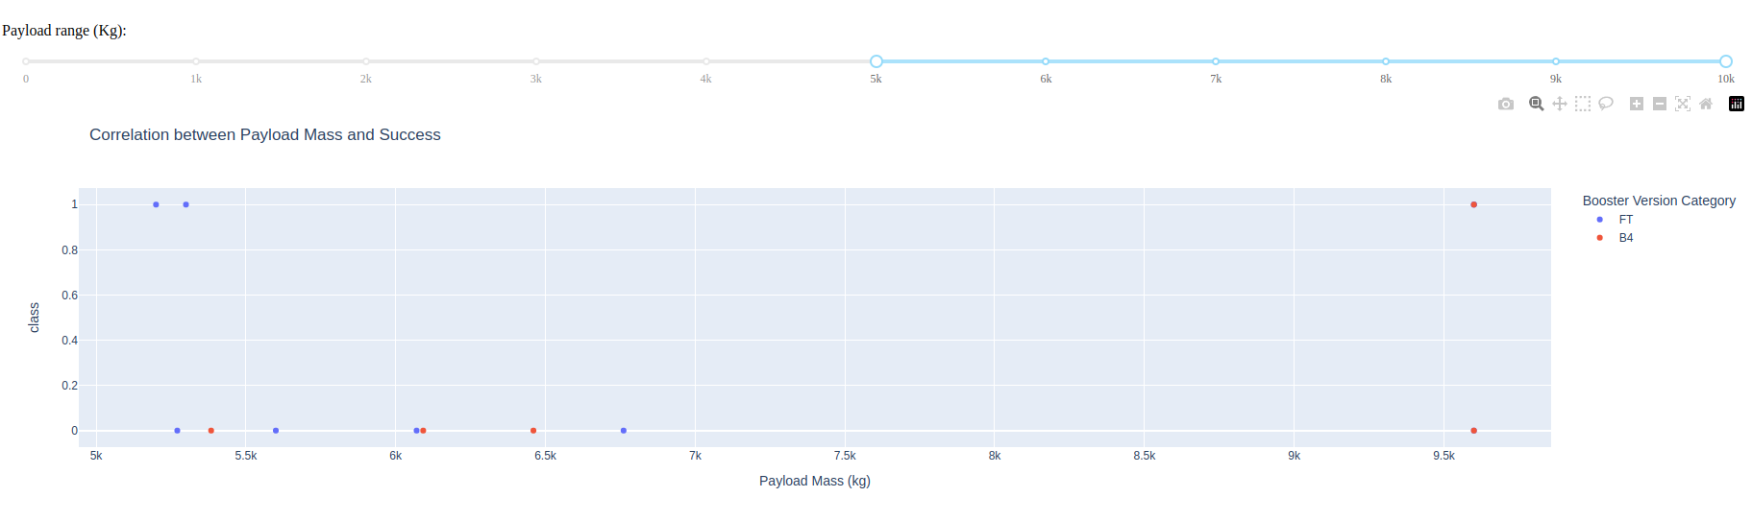
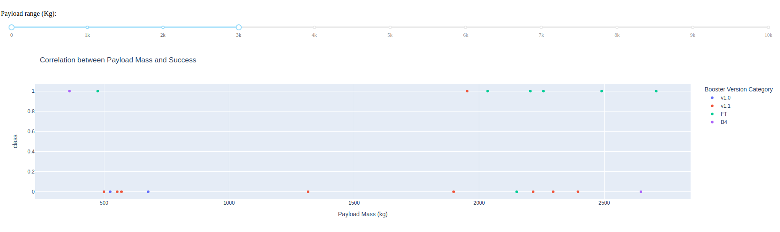
Payload vs Launch Outcome Scatter Plots
In the high end of payload Mass, the failure rate goes up and only B4 boosters have been used for the highest weight payloads
At the low end FT boosters tend to have the highest success rate and 1.0 boosters have no successes

Slide 42

Section 5

Slide 43
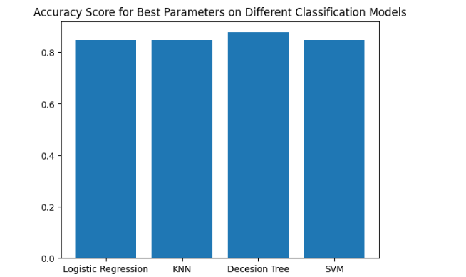
Classification Accuracy
The Decision Tree has the best Accuracy between all classification models tested at:
87.67% Accuracy

Slide 44

Confusion Matrix
The Confusion Matrix of the Decision Tree using the testing data.
Only one classification was incorrectly classified predicting that it did not land when in fact it did.

Slide 45
Conclusions
There are several key fields that play a large role in determining whether or not a launch will be successful:
'FlightNumber', 'PayloadMass', 'Orbit', 'LaunchSite', 'Flights', 'GridFins', 'Reused', 'Legs', 'LandingPad', 'Block', 'ReusedCount', 'Serial'
The best classification model tested was the Decision Tree Classifier with 87.67% accuracy
SpaceX has been trending towards more successful launches as time goes on

Slide 46
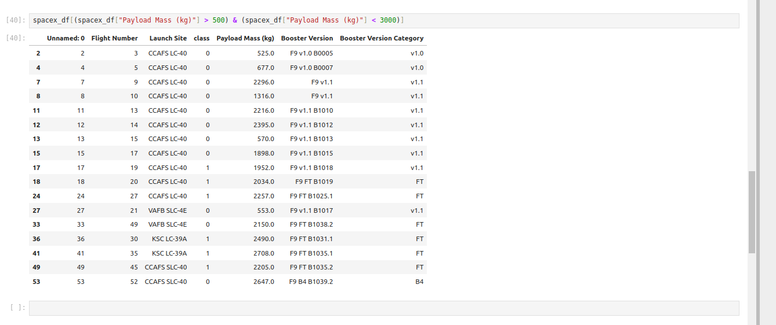
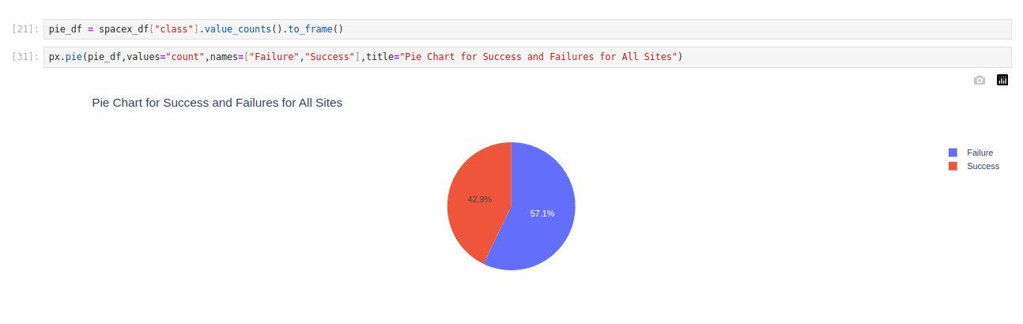
Appendix

Slide 47


